Slide 1

COFFEE RATING
Presentation by NingTang

Slide 2

Content
Dataset
Background
Visualisations
Critical Evaluation & Opportunities for Improvement
Notes:
It’s the outline notes for project presentations.
State the purpose of the analysis: I want to study the relationship between coffee ratings and various factors through the coffee rating dataset, and in the process present the findings clearly through data cleaning, data visualisation

Slide 3
Dataset
Coffee Quality Database
From Tidy Tuesday's 2020-07-07 coffee rating dataset
Total 43 columns: coffee species, country of origin, farm name, and 11 indicators related to coffee quality scores.
Notes:
This dataset is a subset of the Coffee Quality Database and contains coffee rating data from the Coffee Quality Institute (CQI).
1. Describe where the dataset comes from: Tidy Tuesday's 2020 -07-07 coffee rating dataset
2. Describe what the dataset contains: Coffee quality rating data, covering multi-dimensional information from bean cultivation, processing to quality assessment, including basic information about the bean, rating dimensions (e.g. Flavour, Acidity, etc.).

Slide 4
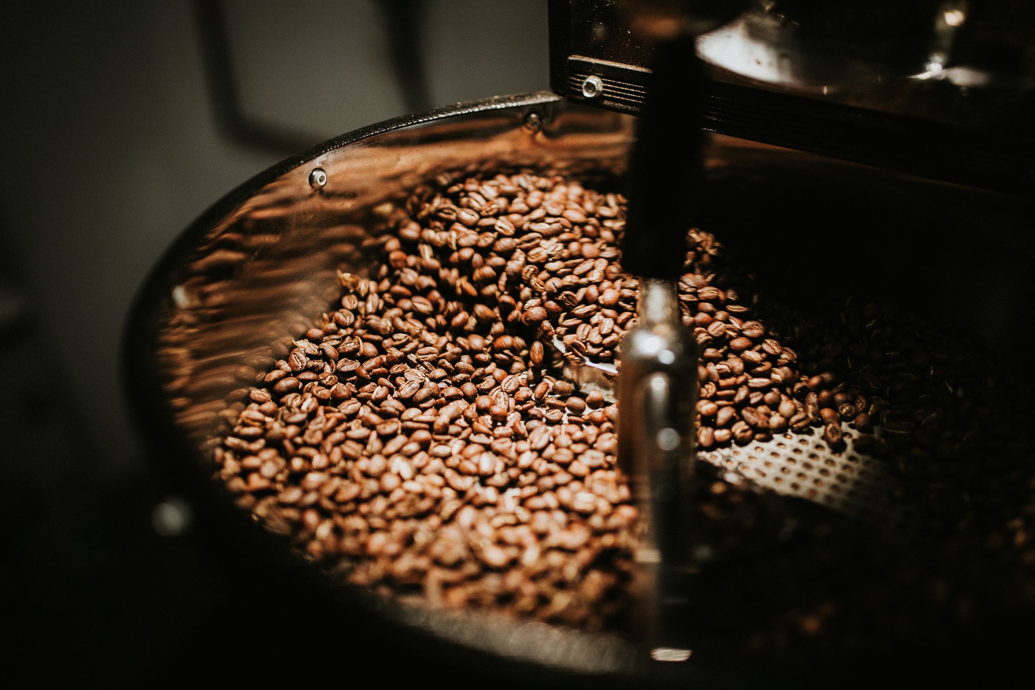
Background
Why research coffee ratings？
Better coffee quality：market Competitiveness+, production chain+, sustainable cultivation+
Fair trade：exploitation-, labour right+, market transparency+
Notes:
This slide explains Why i choose to research coffee ratings
1. By studying the influencing factors of high scores coffee, it is conducive to improving coffee quality, increasing market competitiveness, meeting diversified consumer demands, promoting industrial upgrading and facilitating sustainable agricultural development
2. Fairtrade coffee promotes sustainable development through better trading conditions for coffee bean growers, reduces labour exploitation such as the use of child or forced labour and promotes market transparency

Slide 5
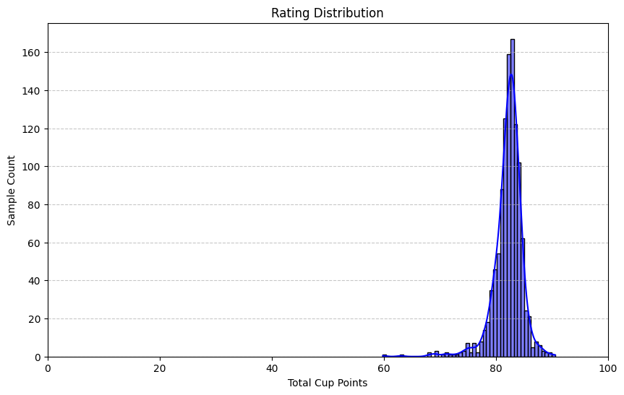
Coffee Ratings Distribution
Findings: mainly concentrated in the 70-90 range, distributions show single-peak characteristics
Notes:
1. The histogram illustrates the overall distributional characteristics of the rating data (concentration trend, dispersion and skewness).
2. The results show that the data are mainly concentrated in the high score range (around 80) indicating that the data sample is highly rated and that the dataset is skewed towards high-quality coffees, reflecting the overall high-quality trend in the coffee market.
3. Provide contextual support for analysing relationships between variables (e.g. ratings in relation to altitude, country or type).

Slide 6
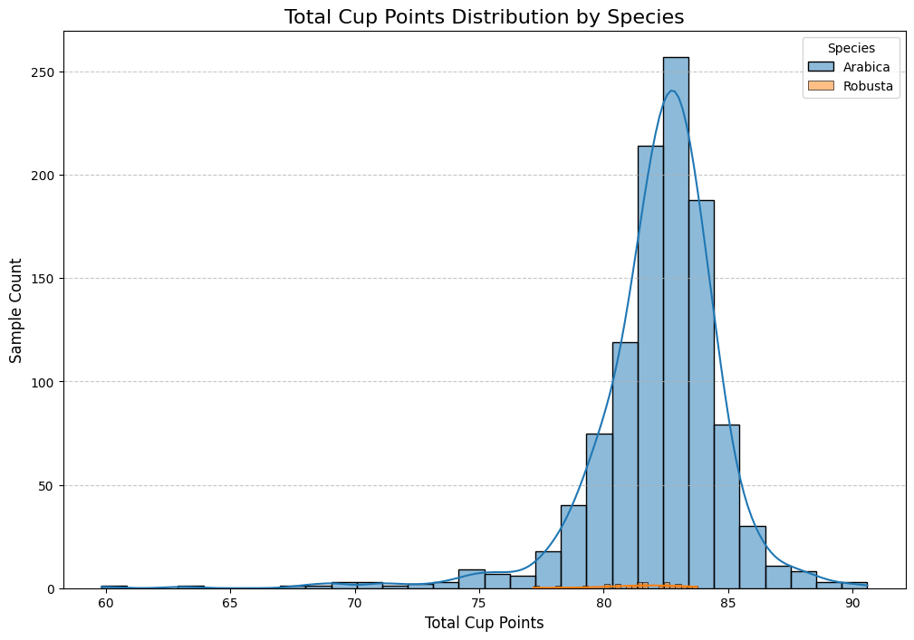
Rating -- Species
The only coffee types in the dataset were Arabica and Robusta.
Findings: The scores of Arabica samples are mainly concentrated in the 80-85 range, with a more concentrated single-peak pattern. the scores of Arabica varieties are more stable and more consistent.
Notes:
1. This histogram shows the characteristics of the data distribution for the two coffee species.
-Arabica has a significantly larger number of samples than Robusta, dominating the blue part of the histogram, with the data concentrated around 80 points, showing a clear single-peaked distribution.
-Robusta has a very low sample size, as evidenced by the orange bars being almost ignored on the scoring axis. The data range is low, distributed between 70-80 scores, with small sample sizes.
2. Arabica's ratings are generally higher than Robusta's, with a more concentrated distribution, reflecting the market positioning of Arabica coffee as a premium coffee, and Robusta does not dominate the speciality ratings dataset.

Slide 7
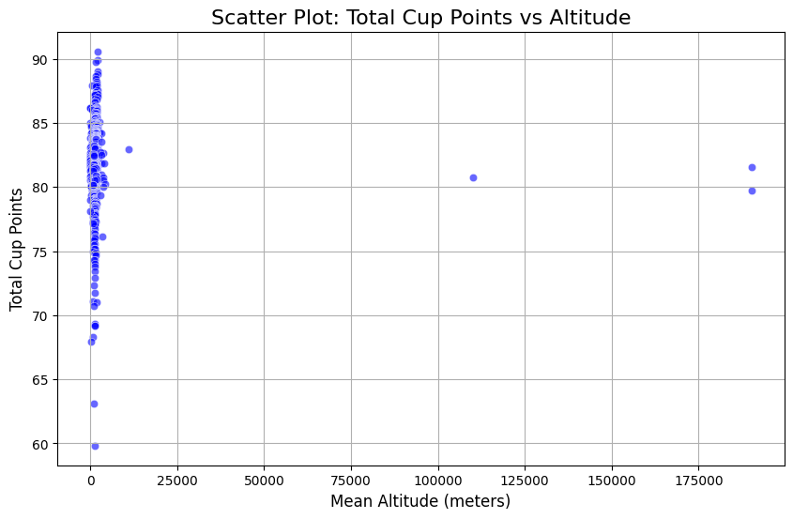
Rating -- Altitude
Findings: low-altitude regions were the main concentration of coffee ratings, ratings did not vary with altitude, the relationship between ratings & altitude may be weak
Notes:
1. This scatterplot shows that most data points are concentrated at low altitudes (<3000 m), with a few anomalies occurring at very high altitudes (>100,000 m) (possibly an error in data entry).
2. Did not show a clear trend and there was no clear correlation between altitude and ratings.

Slide 8
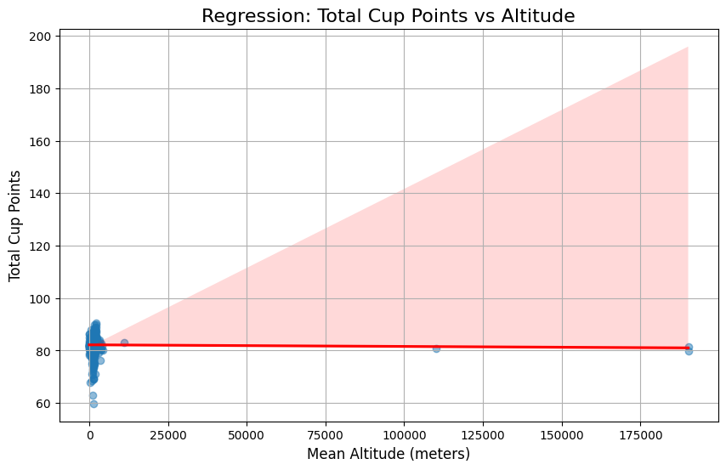
Rating -- Altitude
The results of the regression analyses showed a lack of significant association between elevation and ratings.
Findings: few data points in high altitude areas, leading to a wide Confidence Interval and small reliability of model predictions
Notes:
The data points are very dense in the lower altitude (0-3000 m) regions, but the regression line does not show a significant slope, which shows that the relationship between scores and altitude is weak in these regions.

Slide 9
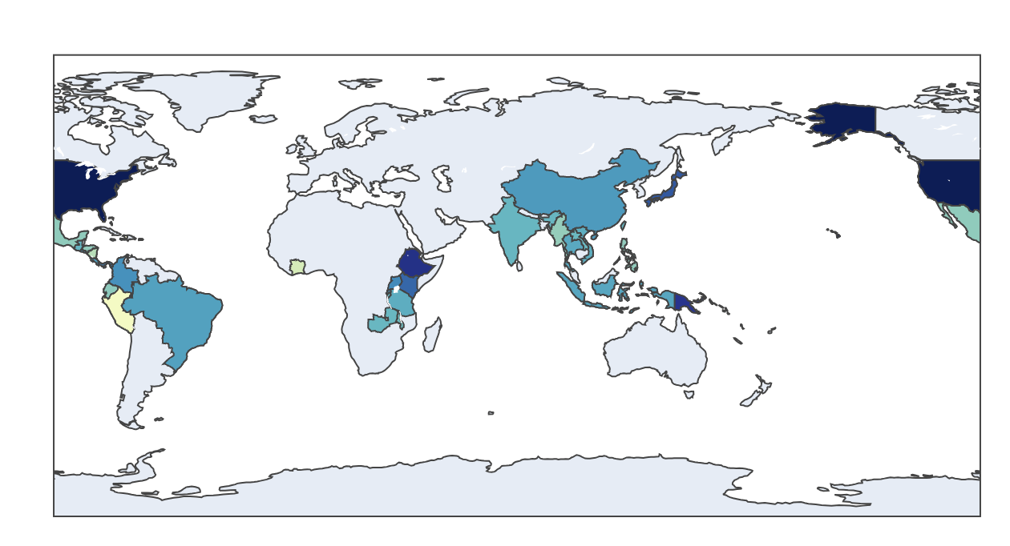
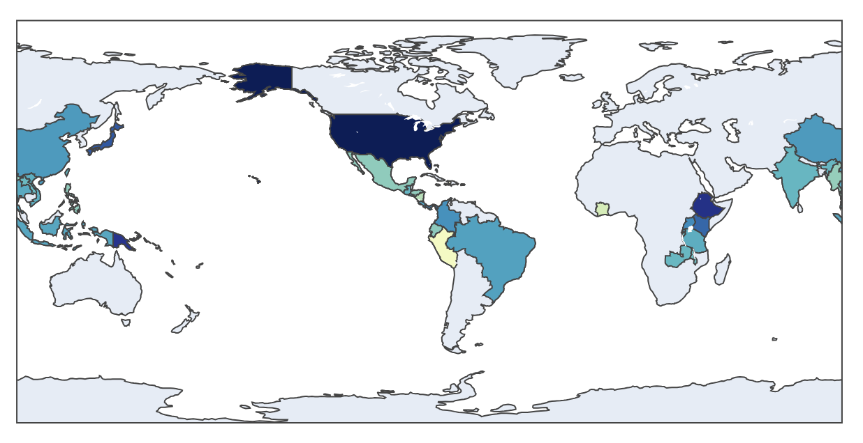
Rating -- Country
High-rated countries: Ethiopia, Colombia and Brazil.
Medium-rated countries: Indonesia, Vietnam and Honduras...
The countries covered by the data are concentrated in the tropics, with no data available for non-tropical regions (e.g. Northern Europe, Russia). This corresponds to the global geographical distribution of coffee cultivation.
Notes:
1. Characteristics of the distribution of rating countries:
- High: These countries produce mainly high-quality Arabica coffee, with favourable growing conditions (e.g. climate, altitude, etc.) and extensive production experience.
-Medium: these countries may produce both Arabica and Robusta coffees, and their coffee ratings fluctuate considerably.
-Low: these countries have lower ratings or smaller data samples.
2. Global distribution of coffee cultivation: the countries covered by the data are concentrated in the tropical regions, which corresponds to the main geographical distribution of coffee cultivation worldwide. Some non-tropical regions (e.g. Northern Europe, Russia) have no data coverage due to lack of coffee cultivation.

Slide 10
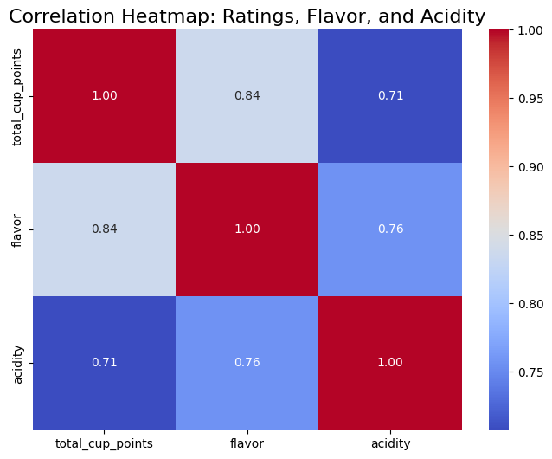
Rating -- Flavor & Acidity
Flavour is a significant factor
Acidity is less important than flavour, proper acidity enhances the taste of the coffee and results in a higher rating.
Notes:
1. Correlation between rating and flavour: 0.84, indicating that the flavour of the coffee has a significant effect on the rating.This means that higher ratings usually correspond to better flavour performance, which is a key factor in coffee rating.
2. Correlation between rating and acidity: 0.71, indicating that acidity also plays an important role in coffee rating.
This indicates that proper acidity will enhance the taste of the coffee and lead to higher coffee ratings.

Slide 11


Critical Evaluation
Challenges Encountered
Opportunities for Improvement
Using Git
Data cleaning
How to handle missing values？
Non-standard data types
Practice Programming
Learn git for better code development
Notes:
I encountered so many difficulties, the first and foremost is the use of github, in the classroom learning after a holiday feel almost forgotten TT, in the beginning spent a lot of time very clumsy operation, but after continuous attempts to constantly modify to be able to finish (although only I think...)
In the data cleaning section, determining missing values and whether the data type is standard or not is also a point where I hit a wall.
In the future, I think it's important to work on my familiarity with operations through practice, and to learn git and use it effectively to track my code development with comments.

Slide 12


THANK YOU FOR YOUR TIME

